Slide 1
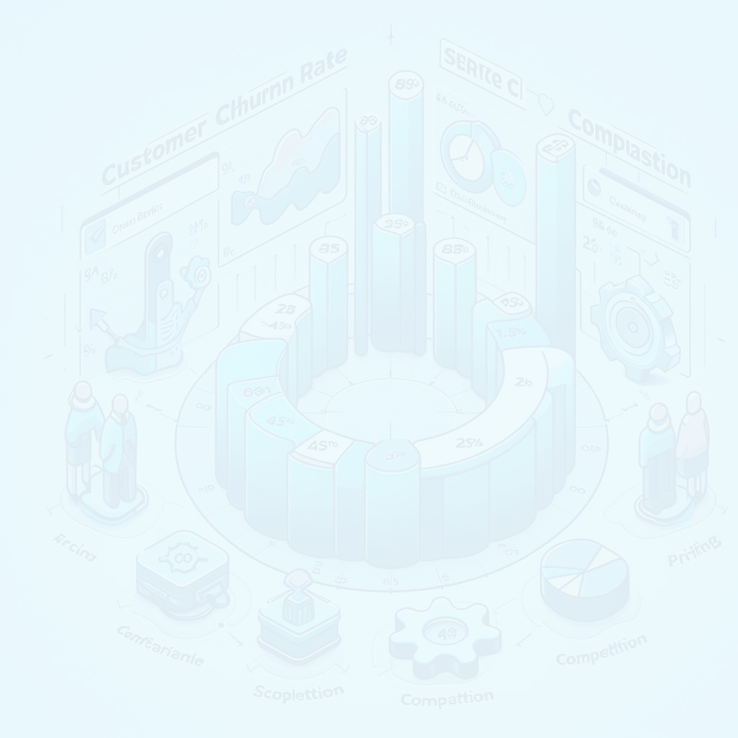


ATTRITIONAI: EMPLOYEE CHURN PREDICTION
Presented by Group 6

Slide 2
Agenda
1
Introduction
2
Related work
3
Our Approach
4
Comparison of Results
5
Future Scope
6
Conclusion
7
References

Slide 3

﻿Meet The Group
Ankit Vikas Agrawal
Mathematical Sciences - Data Science
Srini Narayanrao Vemuri
Mathematical Sciences - Data Science
Rohan Sharma
Mathematical Sciences - Data Science

Slide 4

Introduction
This research initiative addresses the pressing issue of employee churn in contemporary business by leveraging predictive analytics.
The project aims to develop a robust churn prediction model using advanced machine learning algorithms, including logistic regression, Random Forest, XGBoost, and cosine similarity.
Utilizing IBM-provided data and emphasizing comprehensive data cleaning, the approach focuses on proactive communication of churn predictions to HR, providing a curated list of the top 10 potential cases for targeted retention strategies.

Slide 5

Related work
Current approaches to employee churn use academic research Kaggle notebooks, and industry blogs for insights into machine learning and HR interventions.
Challenges include scalability and generalizability.
A holistic approach integrates theory, practice, context, and strategy to manage employee churn effectively.

Slide 6
Description of Dataset
Our employee churn prediction study relies on the 'IBM HR Analytics Employee Attrition & Performance' dataset from Kaggle.
The dataset has minimal missing data, and outlier management excludes 'EmployeeCount,' 'Over18,' and 'StandardHours' for relevance.
These preprocessing strategies optimize dataset integrity, forming a solid foundation for subsequent employee churn prediction research stages.

Slide 7
Our Solution
Our solution for employee attrition is a meticulously designed predictive model that integrates data preprocessing, feature engineering, and advanced analytics.
Balancing both artistic and scientific aspects, our approach provides organizations with a robust framework, harmonizing data-driven methodologies with domain-specific insights for proactive attrition management.

Slide 8
Machine Learning Algorithms
Logistic Regression
Cosine Similarity
Random Forest
XGBoost

Slide 9
Implementation Details - XGBoost
Focusing on XGBoost, our strategy involves in-depth data preprocessing, feature engineering, and model configuration.
We prioritize implementation thorough XGBoost, capitalizing on its ensemble learning quality.
This strategic choice sets the stage for future enhancements, expanding our toolkit to strengthen predictive capabilities and address nuanced factors in employee attrition.

Slide 10
Implementation Details- Cosine Similarity
Unique to our project, the cosine similarity methodology segments the dataset into churned and non-churned employees.
With 237 churned records, we calculate cosine similarity, ranking and selecting the top 10 similar employees for each churned individual.
This list aids HR in proactive retention, minimizing costs by retaining existing employees instead of hiring new ones.

Slide 11
Implementation Details- Logistic
Logistic regression predicts churn using a polynomial model with sigmoid activation, feature normalization, and regularization.
Training includes gradient descent with three dataset permutations for robust assessment.
Analysis of results, including accuracy and confusion matrices, offers insights.

Slide 12
Implementation Details-Random Forest
The Random Forest (RF) classification here is fine-tuned via GridSearchCV, and a subsequent Neural Network (NN) model.
Input for NN features the probabilities on training and testing sets giving robust classification and NN's pattern extraction.
Evaluation metrics (accuracy, precision, recall, and F1 score) were employed to assess the model's predictive performance.

Slide 13
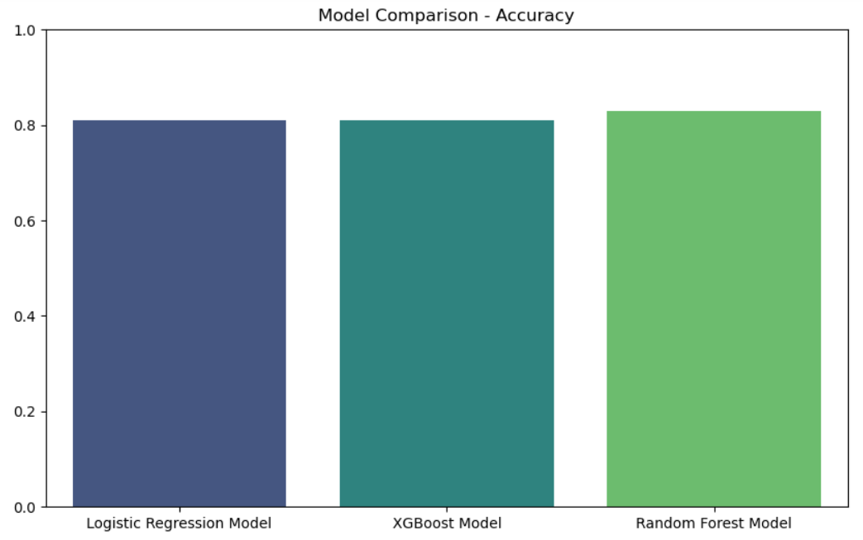
Comparison of Results
Accuracy of 3 Models

Slide 14
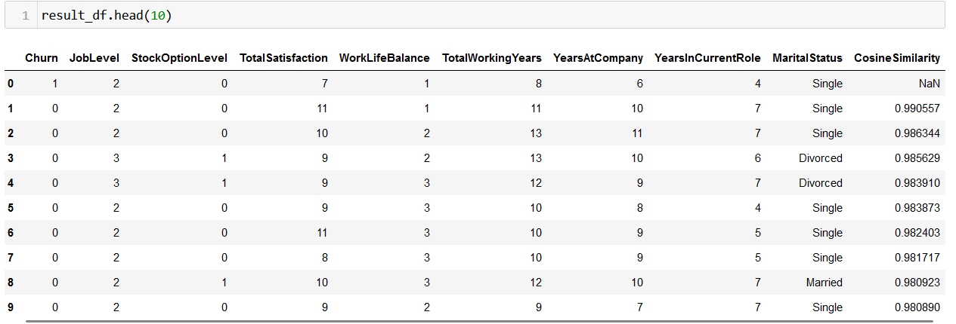
Uniqueness of Project
List of Potential Churners specially developed for HR Department so that the organization can cut down their costs by retaining old employees instead of hiring new employees.

Slide 15
Comparison of Results
Comparing attrition prediction algorithms, Logistic Regression (81.7%) offers simplicity, while Cosine Similarity serves similarity identification. XGBoost (81.29%) and Random Forest (83.81%) demonstrate a complexity-performance trade-off, with Random Forest being the most accurate. Ensemble models excel in intricate relationships.
Logistic Regression's simplicity is valuable, and model choice depends on factors like interpretability and computational cost, aligning with prediction objectives.

Slide 16
Future Scope
Our research trajectory aims to enhance employee attrition prediction.
Exploring refined feature engineering promises a nuanced understanding of influential factors.
Future directions include algorithmic diversification, advanced feature engineering, temporal considerations, industry collaborations, and continuous model validation, strengthening the framework's robustness.

Slide 17
Conclusion
We use predictive analytics and machine learning to anticipate employee attrition.
Our unique cosine similarity methodology identifies potential churners.
Future improvements include advanced algorithms, better feature engineering, and ongoing validation.

Slide 18
References
https://ieeexplore.ieee.org/document/8528586
https://mode.com/blog/predicting-and-preventing-churn/
1
6
2
https://www.kaggle.com/datasets/thedevastator/employee-attrition-and-factors
https://arxiv.org/ftp/arxiv/papers/1912/1912.11346.pdf
7
3
https://www.kaggle.com/datasets/kadirduran/hr-dataset/data
8
https://arxiv.org/pdf/2309.14390.pdf
https://ieeexplore.ieee.org/document/8075270
https://medium.com/@aaysbt/employee-churn-analysis-be94751e4df5
4
9
5
https://www.kaggle.com/code/hamzaben/employee-churn-model-w-strategic-retention-plan
https://staircase.ai/learn/churn-prediction/
10

Slide 19
Zoom Recording Link
https://stevens.zoom.us/rec/share/OZRgu2qx4jqh9XVc_GuG4llk5WPkVws1W7w4Ip0velmDUdMObmjuc617QaWnZd7y.YrbhJgzZsJny0mi7?startTime=1702605245000

Slide 20
﻿THANK YOU!

